Slide 1
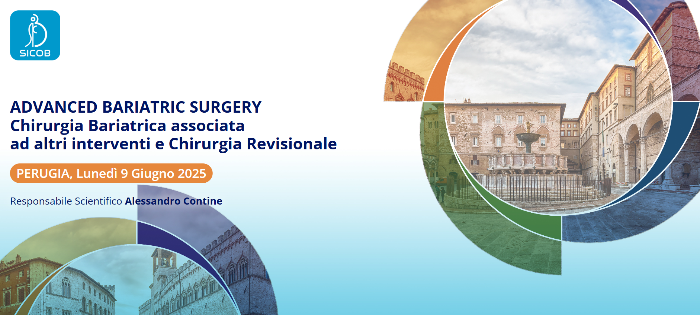
GESTIONE CHIRURGICA DELLE FISTOLE IN CHIRURGIA BARIATRICA
DR. SSA LAVINIA AMATO
S.C. Chirurgia Generale
P.O. Città di Castello
Dir. Dott Maurizio Cesari

Slide 2

“Leak is defined as a transmural defect with communication between the intra and extraluminal compartments, while fistula is defined as an abnormal communication between two epithelialized surfaces”
INCIDENZA
0,4 – 5,6% RYGBP
1,9 – 5,3 SG
POST CHIRURGIA DI REVISIONE
Choosing the best endoscopic approach for post-bariatric surgical leaks and fistulas: Basic principles and recommendations
Victor Lira de Oliveira, et al..
World J Gastroenterol 2023 February 21; 29(7): 1173-1193
MORTALITA’
0,2 – 0,4 %
DOVUTA A DIAGNOSI TARDIVA E/O TRATTAMENTO DELLE COMPLICANZE
0.5% NEI CENTRI AD ALTO VOLUME

Slide 3
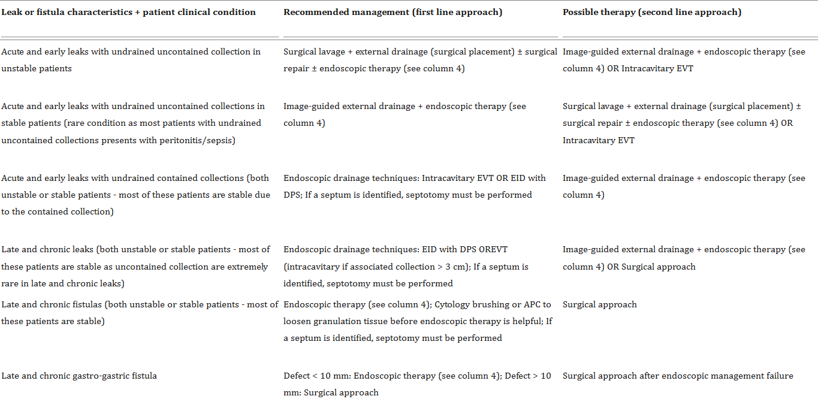

There is no gold standard approach for these patients and usually more than one endoscopic intervention is required, especially in a chronic scenario. Furthermore, combined therapies may be required for some patients to achieve clinical success.

Slide 4

TIMING
ACUTE: < 30-45 GIORNI
CRONICHE: > 45 GIORNI
Endoscopic Management of Post-bariatric Surgery Fistula: a Tertiary Care Center Experience. Benosman et al.. Obes Surg 2018
Outcomes of a novel bariatric stent in the management of sleeve gastrectomy leaks: a multicenter study. de Moura EGH. Surg Obes Relat Dis 2019;
ACUTE: <7 GIORNI
PRECOCI: tra 1 e 6 SETTIMANE
TARDIVE: > 6 SETTIMANE E < 3 MESI
CRONICHE: > 3MESI
International Sleeve Gastrectomy Expert Panel Consensus Statement: best practice guidelines based on experience of >12,000 cases. Diaz AA, Basso N, Gagner.
Surg Obes Relat Dis 2012

Slide 5
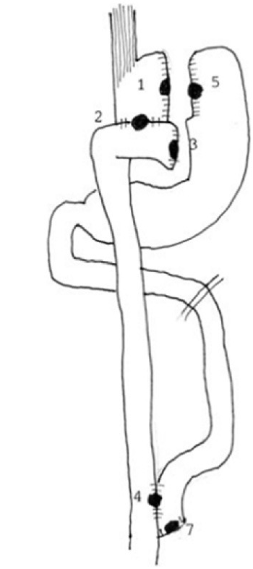
POSIZIONE
TIPO I: TASCA GASTRICA
TIPO II: GJ ANASTOMOSI
TIPO III: MONCONE DIGIUNALE
TIPO IV: J-J ANASTOMOSI
TIPO V: REMNANT
TIPO VI: MONCONE BILIARE prossimale
TIPO VII: MONCONE BILIARE distale
Management of leakage and fistulas after bariatric surgery Stephen A. Firkins , Roberto Simons-Linares Bariatric and Metabolic Endoscopy, Digestive Diseases 2024
Classification and management of leaks after gastric bypass for patients with morbid obesity: a prospective study of 60 patients. Csendes A, Burgos AM, Braghetto I. Obes Surg 2012

Slide 6
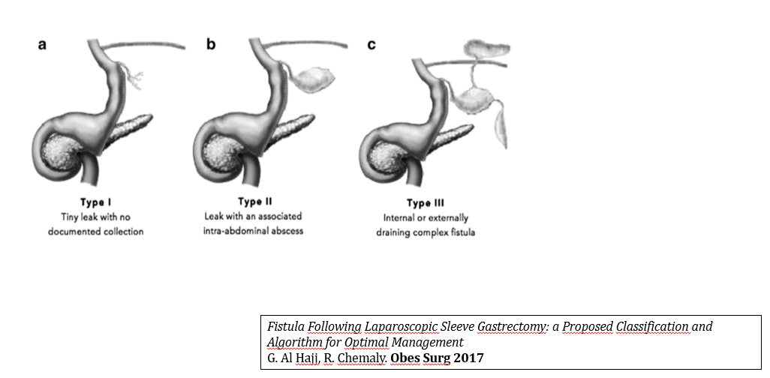

Slide 7

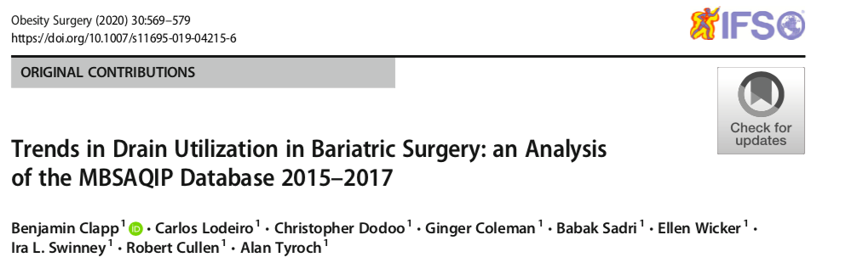
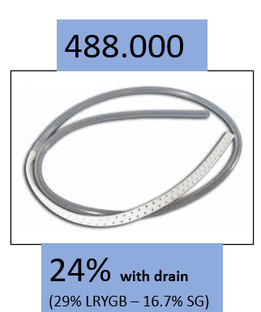
TO DRAIN OR NOT TO DRAIN…?
PZ/PROCEDURE DI MAGGIOR COMPLESSITA’
“…Patients with a drain were more likely to have had a provocative test and a swallow study and have a higher rate of complications and mortality…” > LEAK AUMENTATO DEL 30%

Slide 8
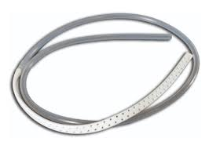
Il drenaggio non modifica la gestione nella diagnosi: tc e/o esplorazione
Il drenaggio non influisce positivamente nella risoluzione
Il drenaggio non riduce il tasso di reintervento
Il drenaggio non è necessario per una gestione post-operatoria sicura
Non serve a prevenire nè a migliorare una perdita
Il loro uso routinario dovrebbe essere scoraggiato
Routine drain placement in Roux-en-Ygastric bypass: an expanded retrospective comparative study of 755 patients and review of the literature. Kavuturu S, Rogers AM, HaluckRS
Obes Surg 2012

Slide 9
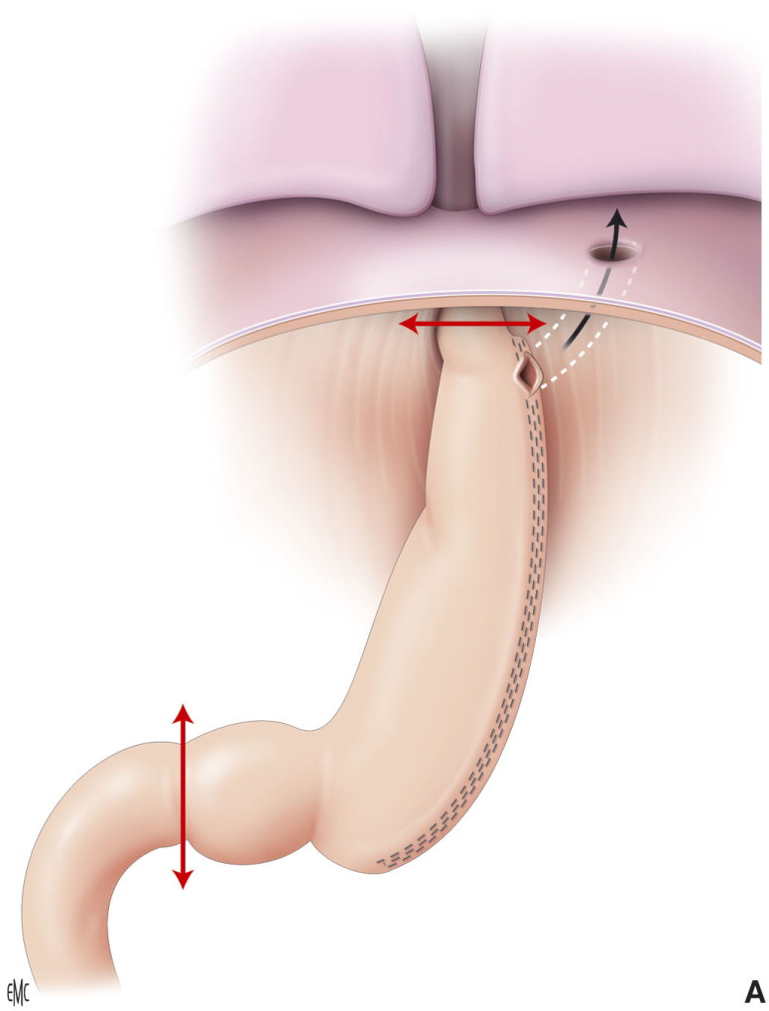
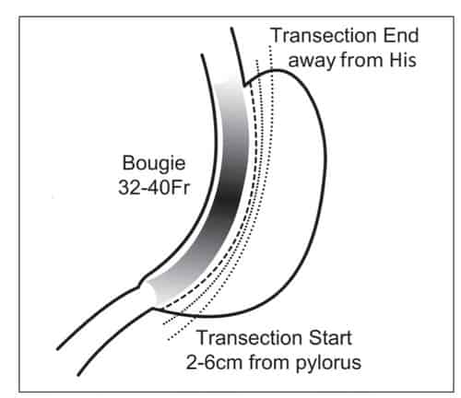
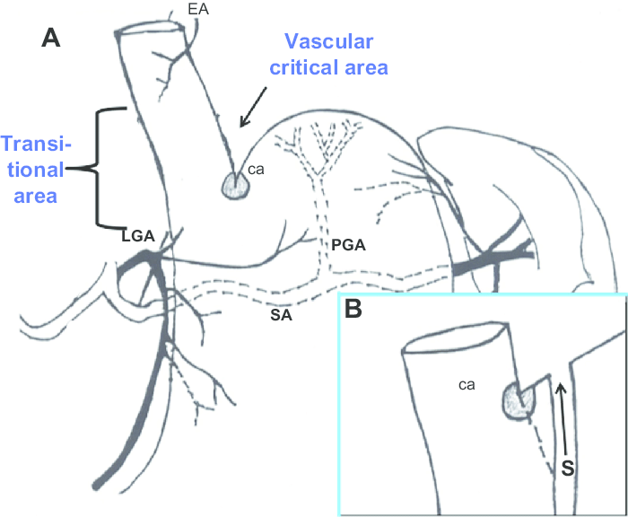
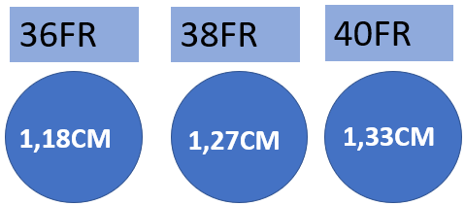
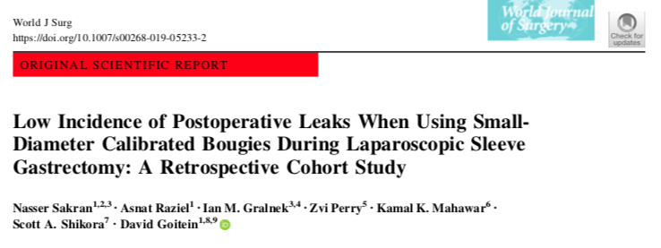
“…The smaller the bougie size and the tighter the sleeve, the higher the incidence of leaks…”
SLEEVE: 90% ANGOLO DI HIS
92% consenso Sondone 36-40 Fr
International Sleeve Gastrectomy Expert Panel Consensus Statement: best practice guidelines based on experience of >12,000 cases. Diaz AA, Basso N, Gagner. Surg Obes Relat Dis 2012

Slide 10
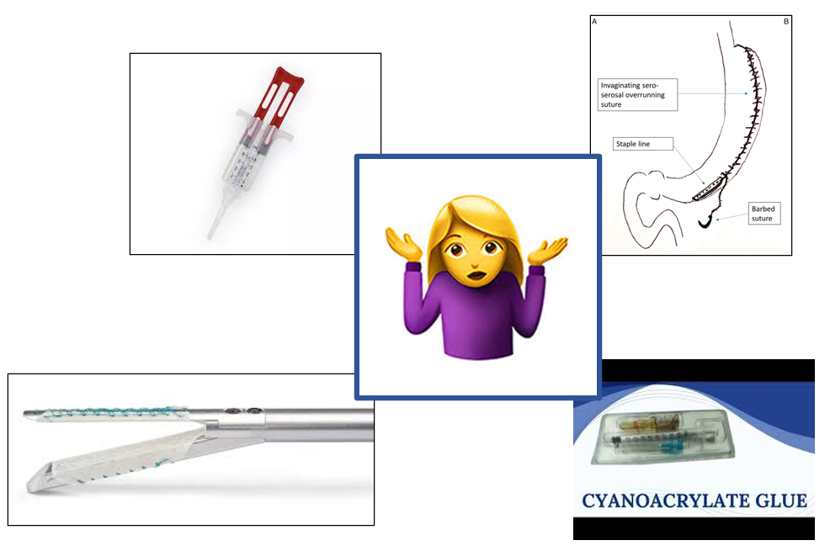
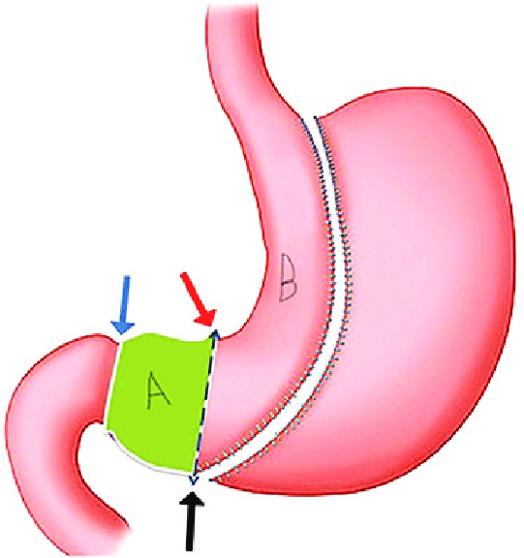
GESTIONE CHIRURGICA PREVENTIVA??
Evitare tensione sull’anastomosi
Rispettare il complesso antro-pilorico (2-6 cm)

Slide 11
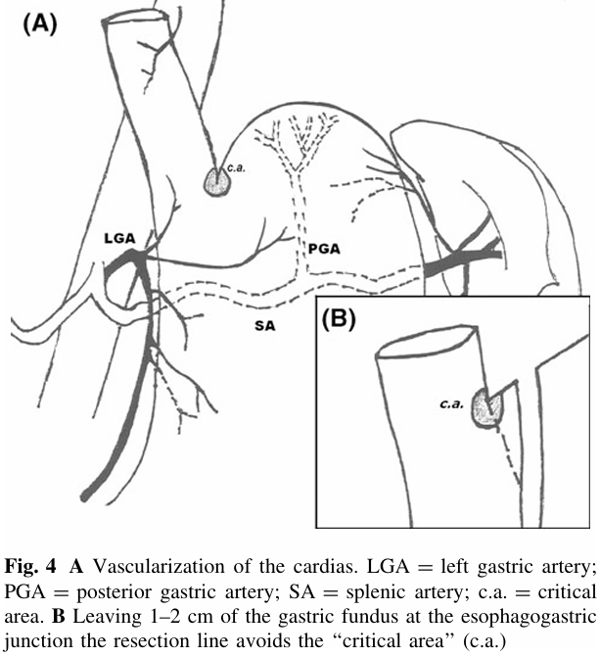
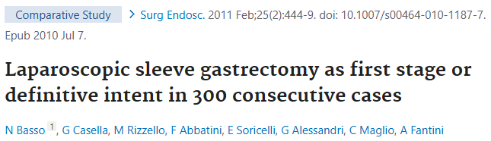
A ‘‘critical area’’ of vascularization may occur laterally, just at the esophagogastric junction at the angle of His.
A resection line avoiding the ‘‘critical area’’ by leaving 1–2 cm of gastric remnant just at the gastroesophageal junction may partly solve the problem !!

Slide 12

DOLORI ADDOMINALI
TACHICARDIA
FEBBRE
DISPNEA
FINO AI CASI PIU’ GRAVI CON SEGNI DI SEPSI
LEUCOCITOSI, PCR E PROCALCITONINA
RICONOSCERE LA FISTOLA (TC ADDOME CON GASTROGRAFIN!!!!)
VERIFICARE LE CONDIZIONI GENERALI
DRENARE
e/o
PORTARE IL PAZIENTE ALL’ENDOSCOPISTA
?
?
?
RYGBP: più precoce anche durante il ricovero
SG: più tardiva dopo la dimissione
M. Al Zoubi, N. Khidir, M. Bashah Challenges in the Diagnosis of Leak After Sleeve Gastrectomy: Clinical Presentation, Laboratory, and Radiological Findings. Obes Surg 2021 Feb;31(2):612-616

Slide 13
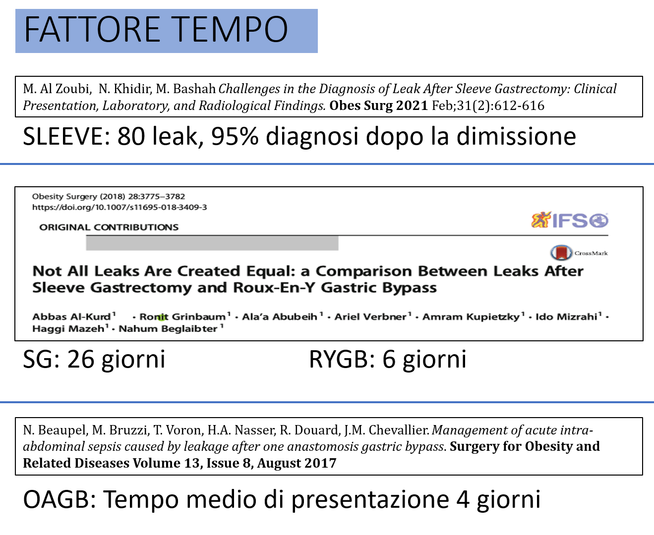

Slide 14
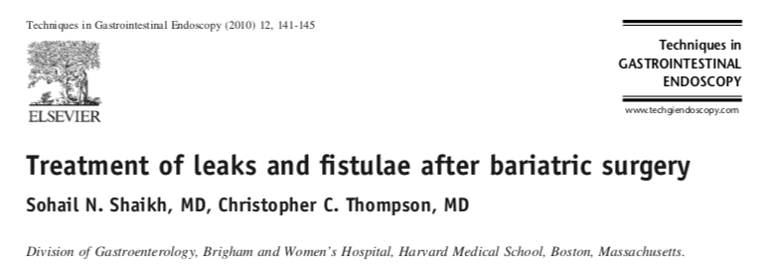
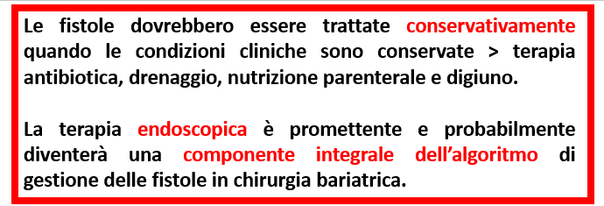
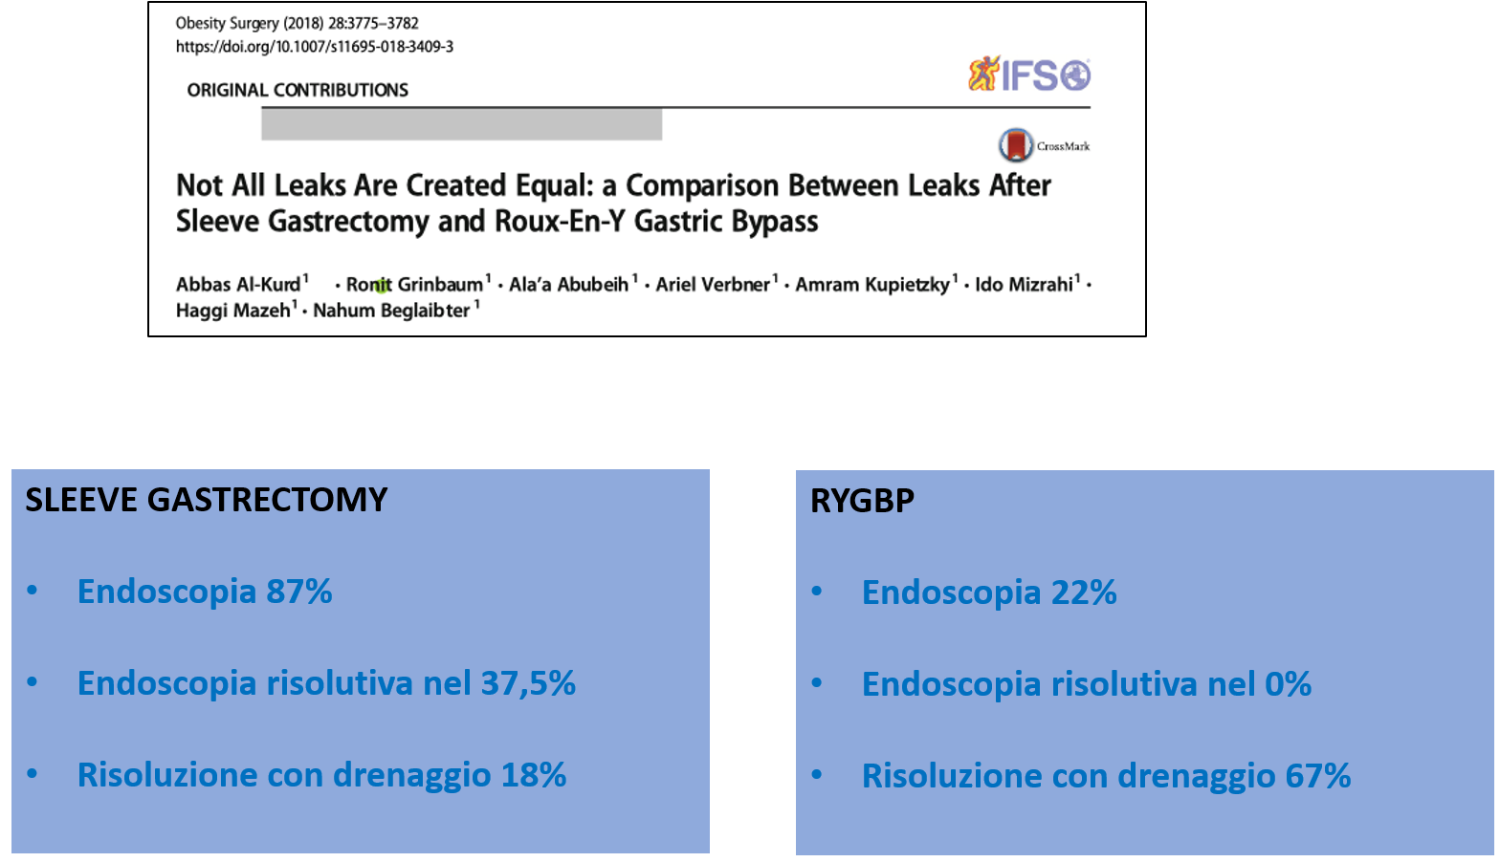

Slide 15

ESPLORAZIONE CHIRURGICA >>>>
Solo in caso di sepsi o shock settico e condizioni instabili
Sensibilità, specificità e accuratezza superiori alla TC
TC 30% FALSI NEG !!!
Peritonite e segni di sepsi + TC negativa> esplorazione chirurgica
OTTENERE DRENAGGIO + CONTROLLO FISTOLA
ASMBS position statement on prevention, detection and treatment of gastrointestinal leak after gastric bypass and sleeve gastrectomy including the role of imaging, surgical exploration and nonoperative management. 2015

Slide 16
PRINCIPI CHIRURGICI DI TRATTAMENTO DI UN LEAK
Copertura antibiotica ad ampio spettro
Identificare e riparare il difetto
Lavaggio e controllo dell’area contaminata
Garantire un adeguato supporto nutrizionale (jejunostomy/gastrostomy tube)
GASTROEJUNAL LEAK: TISSUES IN GOOD CONDITION?
YES
PRIMARY SUTURING+IRRIGATION+DRAINAGE
NO
WIDE DRAINAGE
JEJUNOJEJUNOSTOMY LEAK: 40% MORTALITY!!!
PROMPT SURGERY IN CASE OF HEMODYNAMIC INSTABILITY/RAPID CLINICAL DETERIORATION
EASIER TO REPAIR +/- DECOMPRESSION OF THE EXCLUDED STOMACH
Bariatric and Metabolic Surgery, S. H. Choi, K. Kasama, Springer 2014

Slide 17
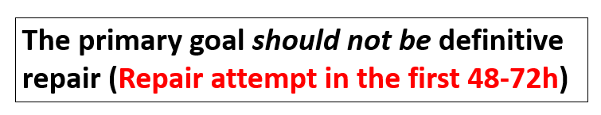
RIPARAZIONE/SUTURA>>>>
ASMBS position statement on prevention, detection and treatment of gastrointestinal leak after gastric bypass and sleeve gastrectomy including the role of imaging, surgical exploration and nonoperative management. 2015
Nel caso di leak a carico dell’anastomosi gastro-digiunale, qualora la condizione dei tessuti lo consenta, può esser eseguita una sutura primaria del difetto, seguita da lavaggio e successivo posizionamento di drenaggio. Qualora la sutura non fosse possibile, un «wide drainage» è un’opzione.
Bariatric and Metabolic Surgery, S. H. Choi, K. Kasama, Springer 2014

Slide 18
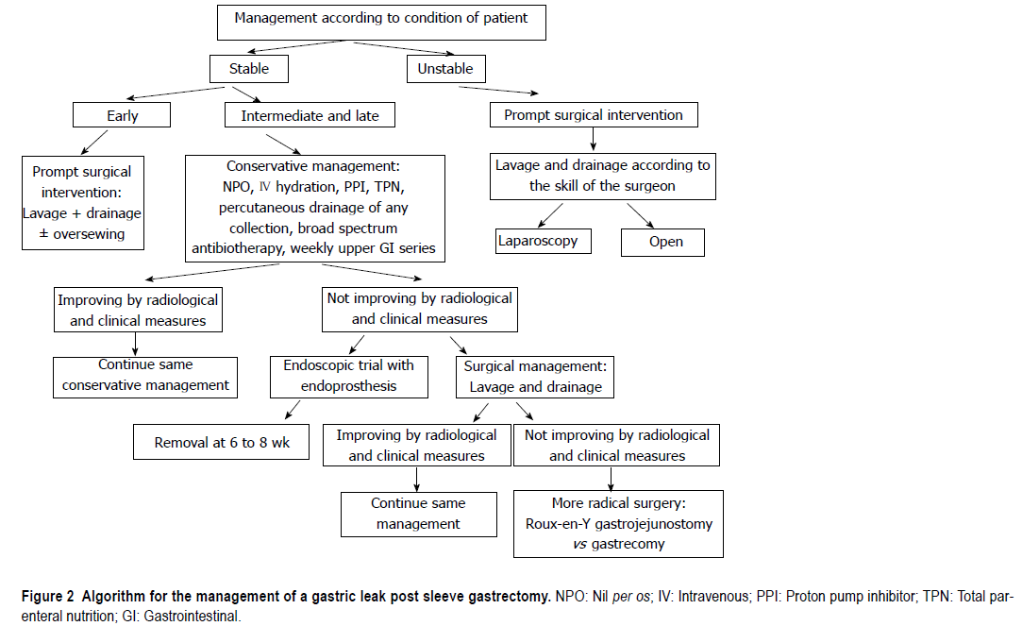
48-72 H

Slide 19
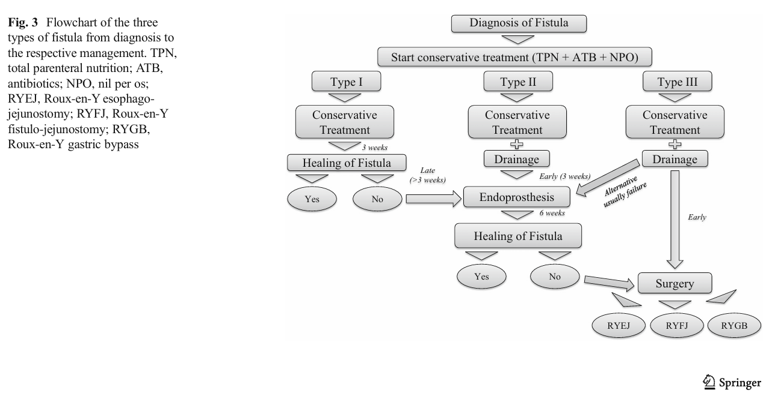
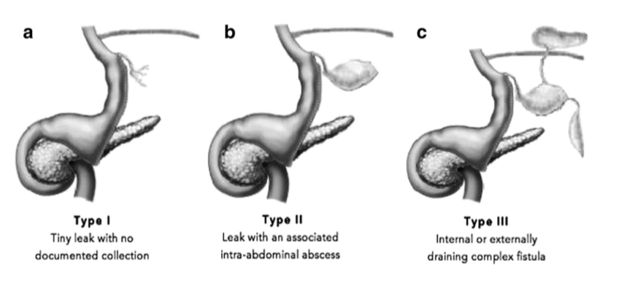
Fistula Following Laparoscopic Sleeve Gastrectomy: a Proposed Classification and Algorithm for Optimal Management
G. Al Hajj, R. Chemaly. Obes Surg 2017

Slide 20
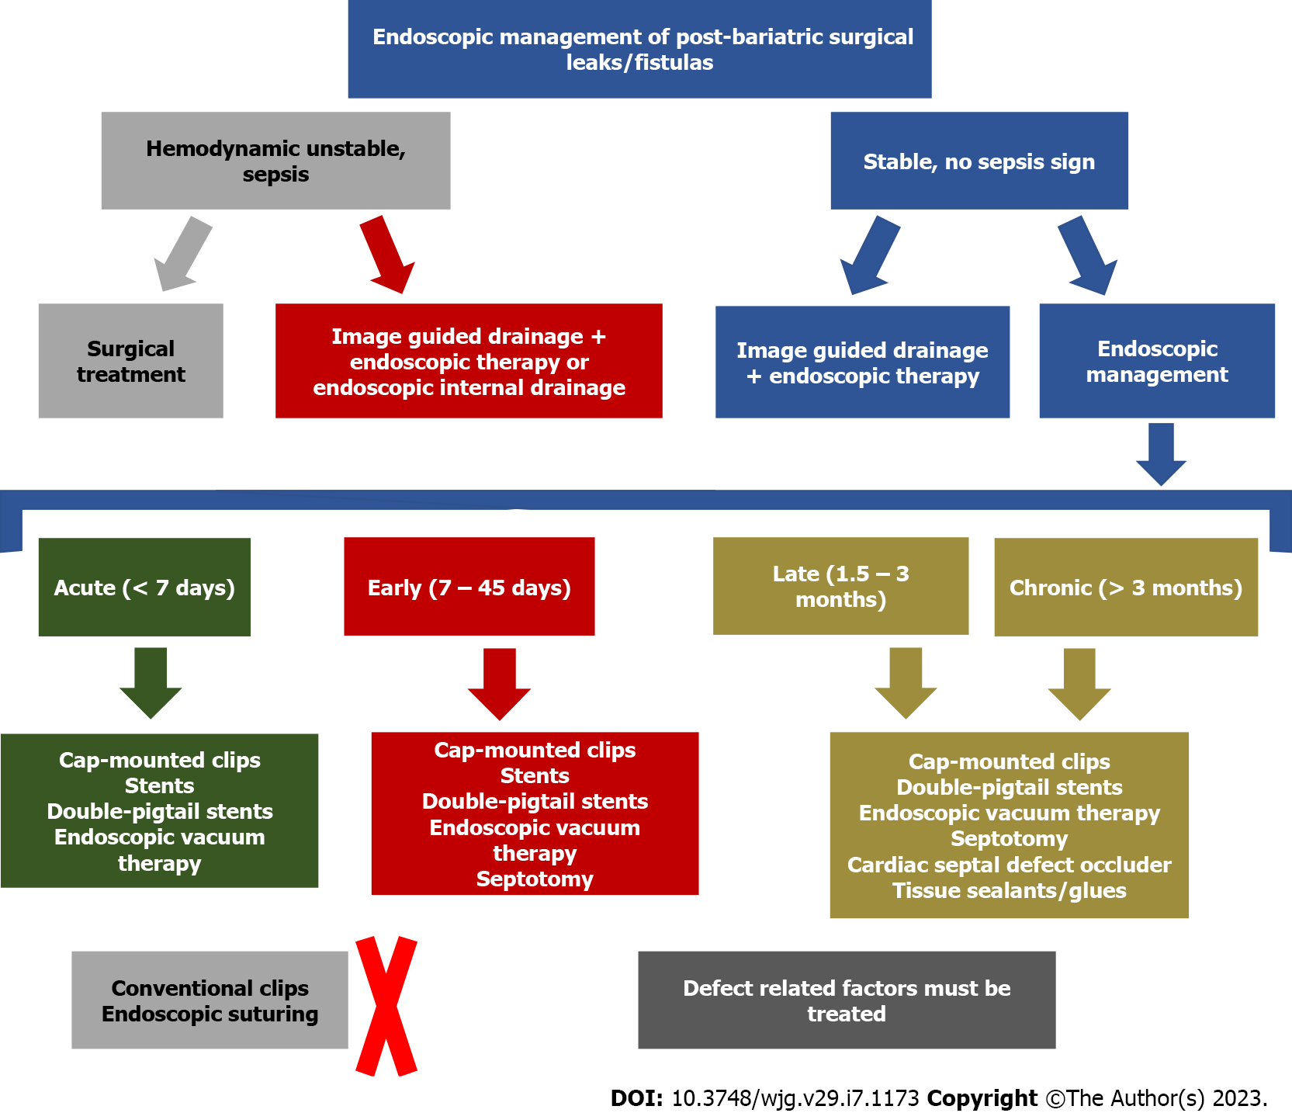
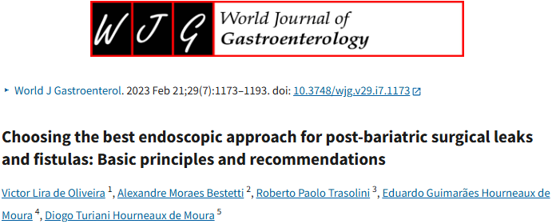
A multidisciplinary team and individualized evaluation considering patient and defect characteristics, available resources, local and personal experience, and knowledge of fundamental principles and mechanisms of action of each technique is essential to choosing the best approach for the management of post-bariatric surgical leaks and fistulas
!! Endoscopic suturing needs robust and healthy tissue around the defect for primary closure. Therefore, this technique is not effective in closing most leaks and fistulas

Slide 21
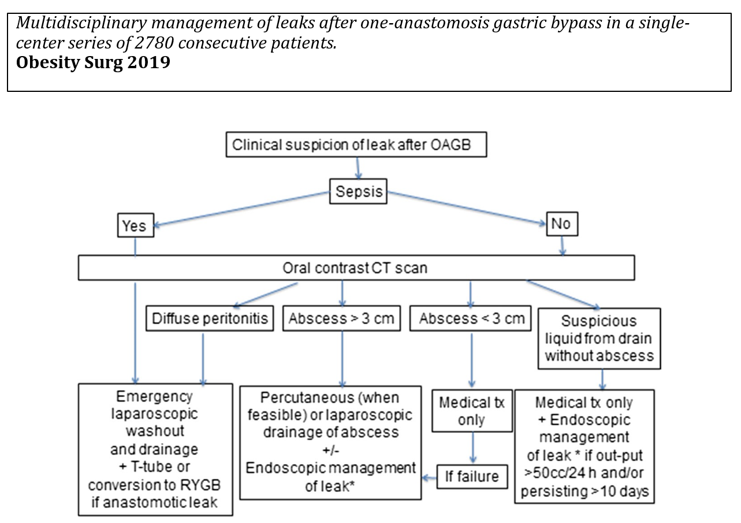
If endoscopy and interventional radiology are available, reoperation can be avoided in most patients. In most leaks at the gastrojejunal anastomosis, inserting a T-tube in the leak orifice avoids the necessity for conversion to RYGB.
2780 OAGB > 46 (1.7% leaks)
20% sola tp medica
50% trattati con endoscopia/ dr PCT
30% laparoscopic management
(washout and drainage plus T-tube placement in 5 cases or conversion to RYGB in one case)

Slide 22
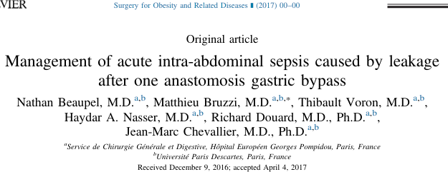
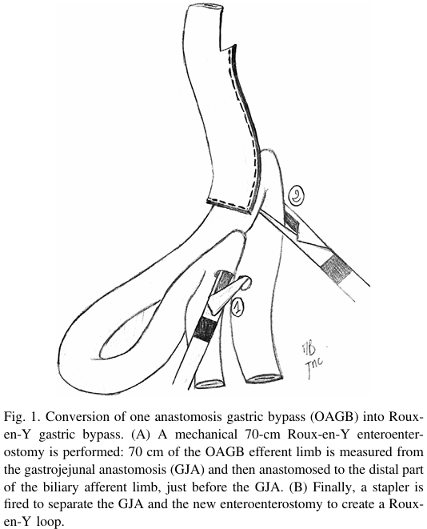
17 pz tra il 2006-2016 con leak diagnosticato 4 gg post OAGB
16 pz trattati chirurgicamente (5 VLS, 11 open)-1 tp conservativa
6 OAGB>RYGB (in case of GJA, gastric-tube, and biliary-limb leakages)
Reduced overall morbidity rate (16.7% versus 83.3%) and shorter lengths of stay in the “conversion to RYGB” group !!

Slide 23
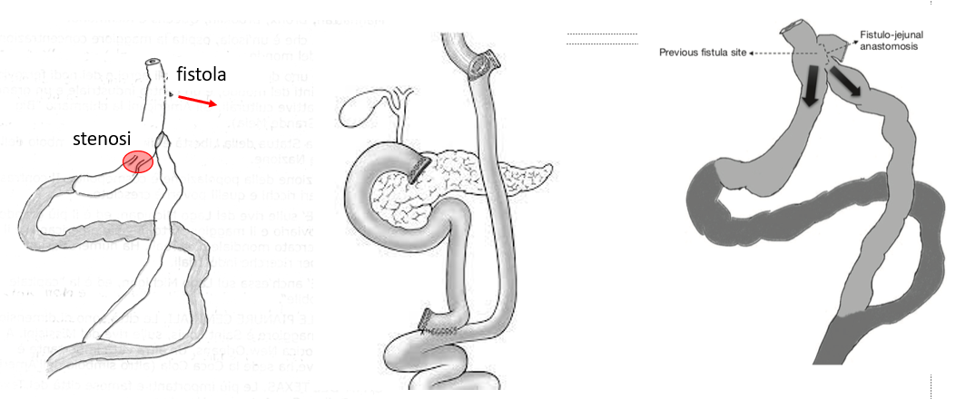
LA FISTOLA CRONICA
CHIRURGIA DI SALVATAGGIO
37 pazienti
81% tratt endoscopico (internal pigtails, stents, septoplasty, endoluminal vacuum therapy and over-the-scope clips)
19% chirurgia salvataggio
Leak < 6 settimane 97% successo endoscopico
Leak > 45 giorni successo endoscopico del 25%
Chirurgia in caso di 4 tentativi endoscopici falliti:
Gastrectomia tot RY Esofago-digiuno anastomosi
RYGBP prossimale alla stenosi
RY fistola-digiuno anastomosi
Long-term follow-up of a cohort with post sleeve gastrectomy leaks: results of endoscopic treatment and salvage surgery. Surg End 2023

Slide 24
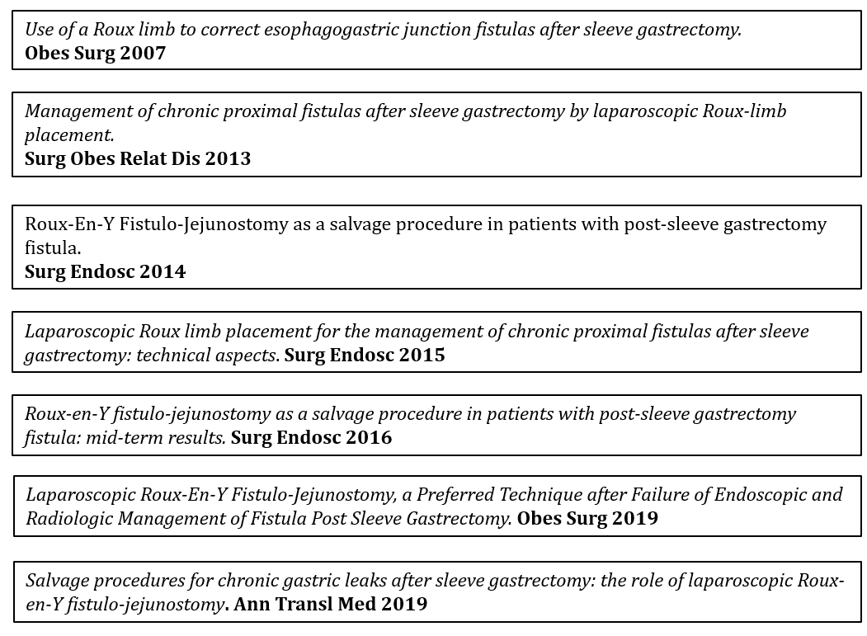
LA FISTOLA CRONICA
CHIRURGIA DI SALVATAGGIO

Slide 25
